Slide 1



Smart Waste Collection Management System
IIT Mandi Catalyst
IIT Mandi Catalyst

Slide 2
Team
Arendra Kumar
Dipanshu
Anuj Pal
Keshav Kumar
Nimit Garg
Utkarsh
Machine Learning
Model and Electronics
App Development
Bin Mechanism and Electronics
Design and
Bin structure
Machine Learning and design
Marketing and electronics

Slide 3
2. Problem Statement and Customer segment
India generates over 62 million tons of waste annually, yet only 20% is scientifically treated. The system faces chronic issues such as inefficient waste segregation, overflowing bins, and lack of public awareness. Traditional waste management methods rely heavily on manual processes, are disconnected, and fail to scale effectively. Compounding these challenges, no communication exists between waste generators and collectors, leading to unhygienic conditions, environmental damage, and untapped recycling opportunities. This results in billions of dollars in economic and environmental losses annually.
Why This Problem Demands Attention:
Massive Unaddressed Market: India has one of the fastest-growing populations and urbanization rates in the world. The waste management sector is vastly underdeveloped, with no holistic, technology-driven solutions dominating the landscape.
Environmental Catastrophe: Overflowing landfills are reaching capacity, leading to pollution, fires, and public health crises in major cities and rural areas alike.
Regulatory Push: With increasing government pressure on sustainability, including mandates for efficient segregation and treatment, there is a growing demand for effective and scalable waste management solutions.
Resource Recovery Opportunity: Up to 60% of waste in India is compostable or recyclable, yet this potential is wasted due to poor infrastructure.

Slide 4
3. Proposed Solution/Product
We are introducing an Intelligent Waste Management System designed to holistically address the challenges of
waste collection, segregation, and monitoring. Our system comprises two integrated components:
Smart Bins Powered by Machine Learning:
ML-Based Waste Segregation: A camera module captures waste images, and an ML model identifies the type (biodegradable, non-biodegradable, or hazardous).
Automated Operation: The bin’s lid opens based on waste classification, ensuring accurate segregation.
LCD Display: Shows real-time feedback (e.g., "Waste is Biodegradable") to educate users.
Sensors: Monitor bin fill levels and prevent overflows.
2.Mobile Application:
Real-Time Monitoring: Tracks bin locations, fill levels, and waste types to ensure efficient collection scheduling
and prevent overflows.
Mess Waste Collection: Empowers mess workers to log daily waste data ensuring transparency and accountability.
Complaint Portal: Enables residents to report overflowing bins or system malfunctions for prompt action.
Communication Channel: Connects waste collection workers with campus residents for seamless coordination.
This combined system eliminates manual errors, enhances user awareness, and ensures cleaner and more sustainable operations.

Slide 5



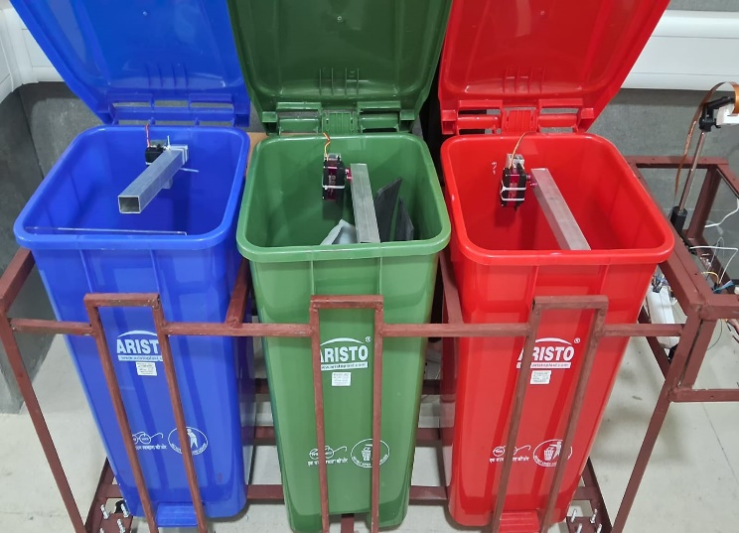
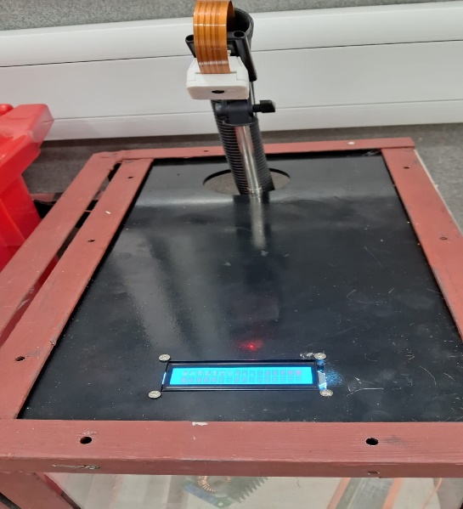
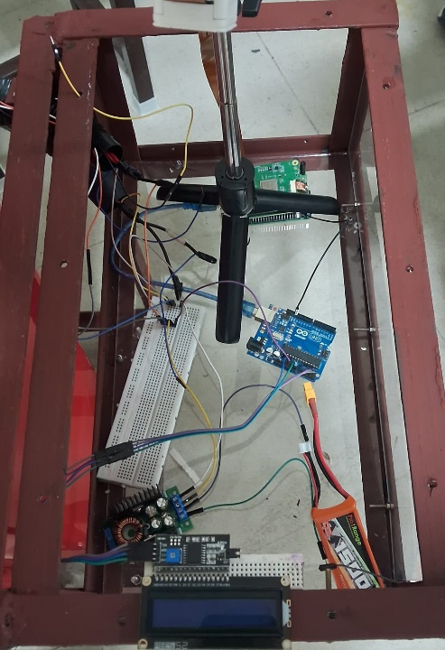
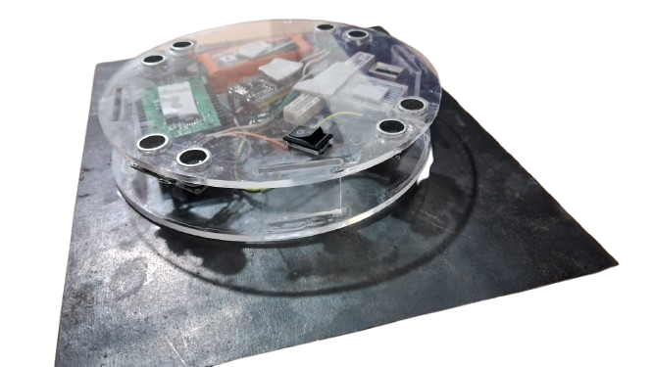
Solution Architecture and Product Design
1
2
3
4
Three dustbins with motorized lids.
Display screen for waste detection
Sensors for waste identification and bin fill levels.
Processing unit for decision-making

Slide 6
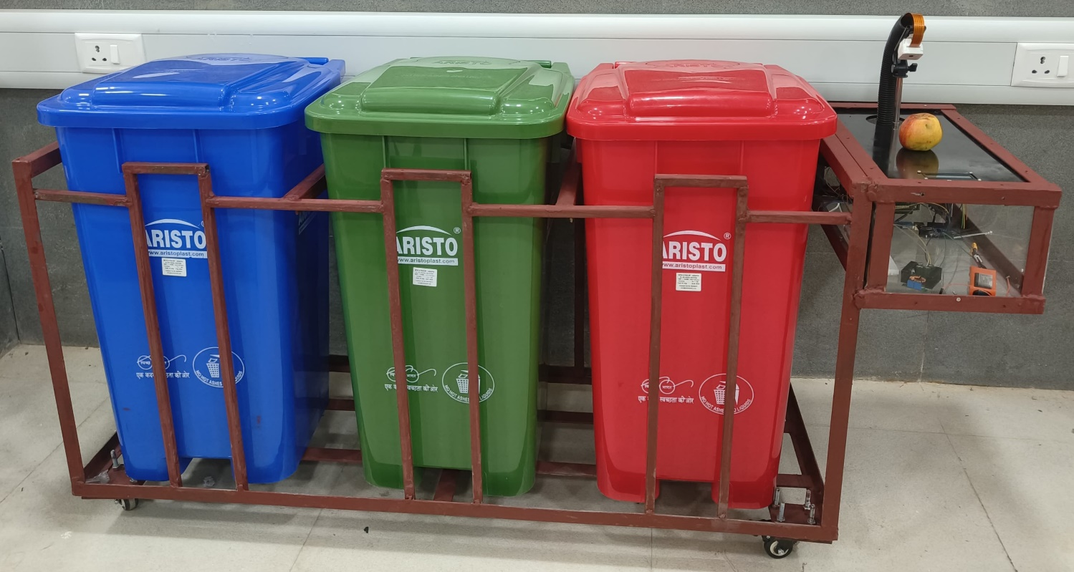
Product Design

Slide 7


SOFTWARE COMPONENTS
Direct Resident to worker Complain System
Alerts for full bins to ensure timely collection
Mess Waste Statistics
Integrated campus map for navigation.

Slide 8
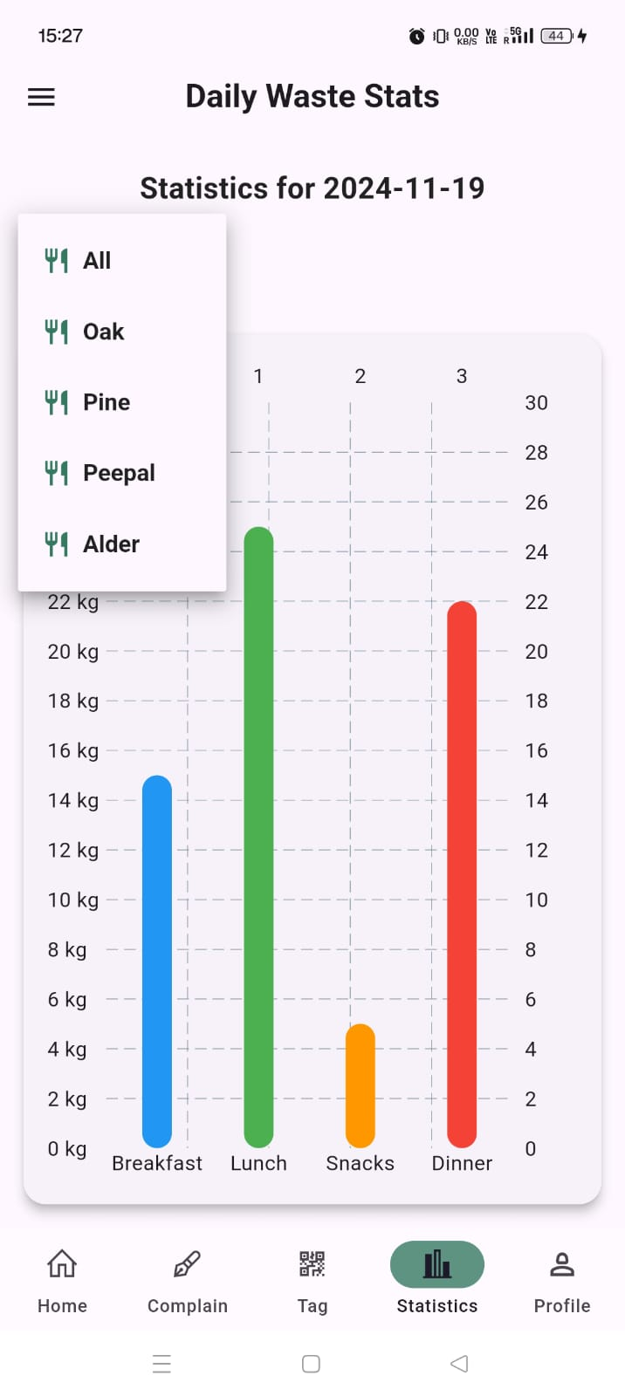
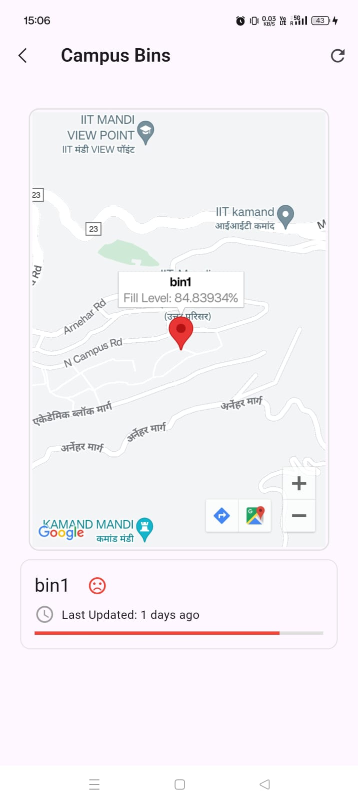

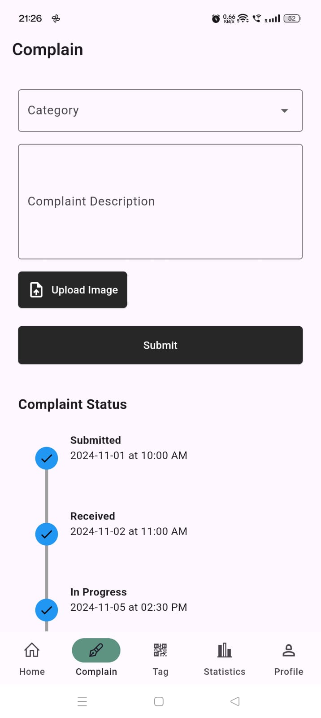
APP FEATURES
For Residents
Smart Bin Locator
Dynamic Complaint System
Waste Status Tracking
Unique Tag
ID

Slide 9
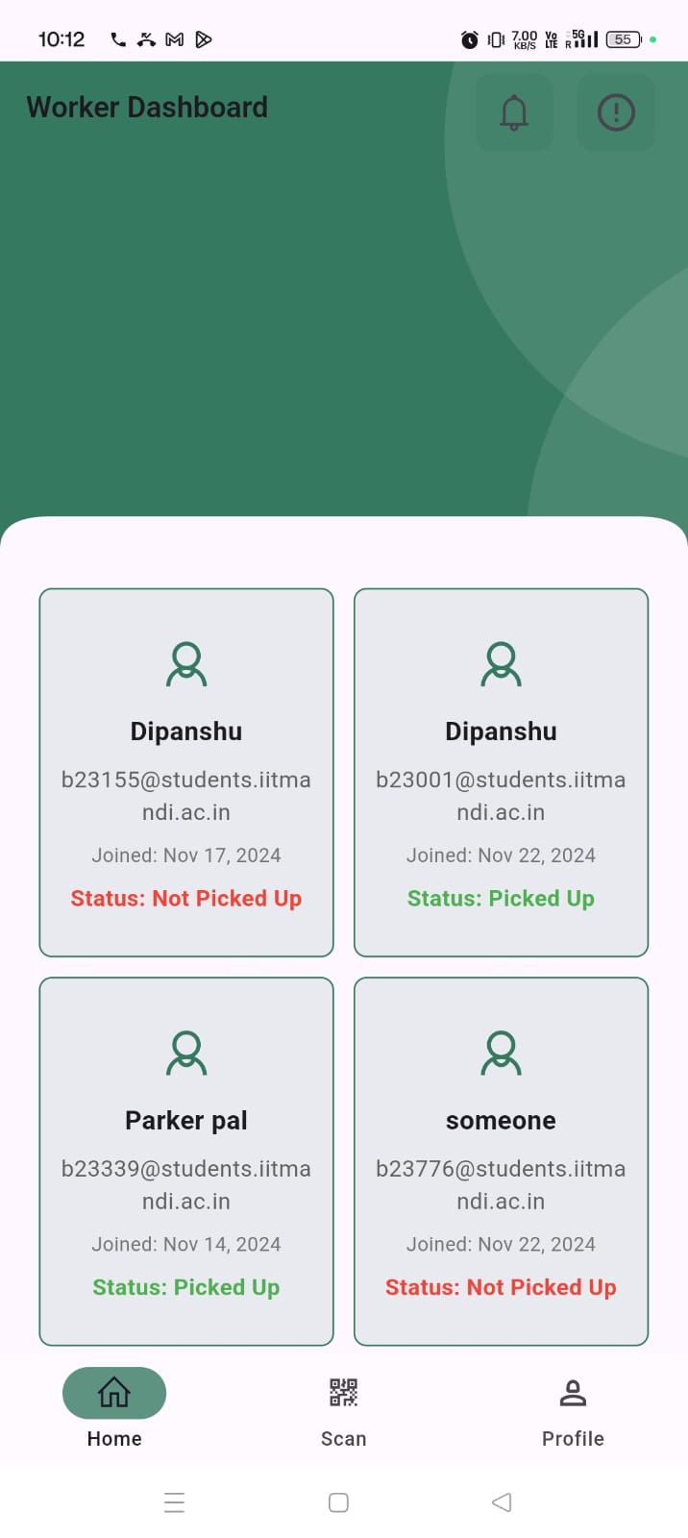
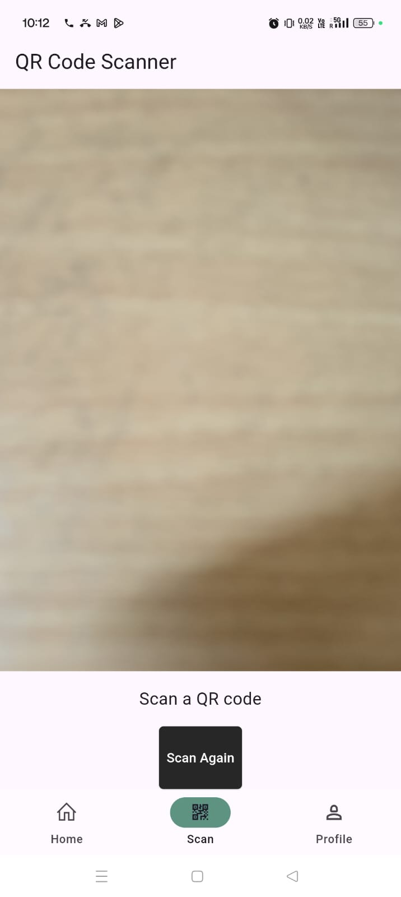
For Waste Collection Workers
Resident Waste Lists
Single-Scan Task Updates

Slide 10
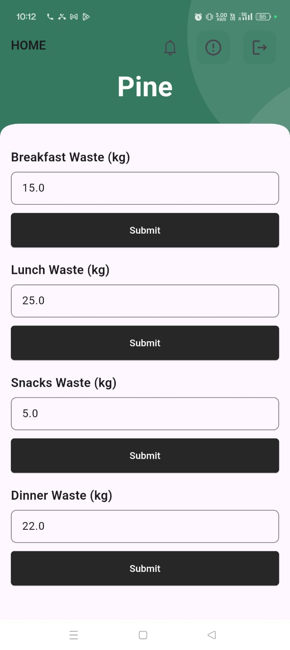
For Mess Workers
Digital Waste Logging

Slide 11
4. Unique Value Proposition
Our intelligent waste management system transforms waste disposal in India by combining AI-powered waste segregation, real-time monitoring, and seamless communication between residents and waste collectors.
Here’s how we relieve key pain points for our customers:
AI-Based Waste Segregation:- ML-powered bins classify waste into biodegradable, non-biodegradable, and others, unlike traditional systems prone to human error.
Overflow Prevention, Hygiene & Real-Time Monitoring:- Sensors track fill levels to prevent overflow and maintain hygiene.
User Education & Feedback: Smart bins provide real-time feedback (e.g., “Waste is Biodegradable”) through LCD screens, educating users on proper disposal
Communication Platform: Our solution integrates direct communication between residents and waste collectors via the mobile app, enabling faster issue resolution and efficient waste collection management.

Slide 12
5. Market Size
Target Customers and Market Size:
1.Schools (Government & Private) :-
Market Size: India has over 1.5 million schools, with a large number in both urban and rural areas.
Pain Points: Lack of waste segregation education, hygiene issues, poor disposal practices.
Interest: Schools focus on educating students about proper waste disposal and segregation. Our mechanical model engages students while promoting sustainable waste practices through innovative technology.
2.Large Campuses & Colleges :-
Market Size: Over 1,000 higher educational institutions (including IITs, private universities, and state colleges) house thousands
of students, creating waste challenges.
Pain Points: Overflowing bins, inefficient waste collection, high volume of waste in messes, hostels, and canteens, inconsistent collection scheduling.
Interest: Our integrated solution helps manage large waste volumes by using real-time tracking and feedback systems. It ensures cleanliness, timely collection, and scalable waste management for college campuses
3.Municipalities & Government (Local Authorities, Swachh Bharat)
Market Size: The urban population in India is expected to reach 600 million by 2031, creating demand for advanced waste management solutions across cities.
Pain Points: Inefficient waste collection, poor segregation at the source, and overflowing bins in urban areas. Manual processes
lead to delays, and sanitation issues remain unchecked.
Interest: Our solution supports the Swachh Bharat Mission by automating waste segregation, providing real-time monitoring, and enhancing collection efficiency. It helps municipalities tackle waste management challenges while promoting cleaner, more sustainable cities.

Slide 13
5. Market Size
4.Private Sector & Waste Management Companies Market Size: The Indian waste management industry is valued at approximately $13 billion and is growing, as private players expand their services in waste sorting and processing. Pain Points: Inefficient waste management processes, difficulty in tracking waste volumes, and optimizing collection schedules. Traditional systems are prone to errors, leading to increased costs and inefficiencies. Interest: Our solution helps waste management companies automate waste sorting, optimize collection schedules, and reduce operational costs, improving overall efficiency and ensuring timely, accurate waste management.
5.Residential Complexes & Housing Societies
Market Size: Urban housing in India is expected to grow to 78 million households by 2025. Pain Points: Inefficient waste collection, lack of proper segregation, sanitation concerns in communal areas. Interest: our solution can help residential complexes efficiently manage waste with real-time bin monitoring, automated collection scheduling, and direct communication between residents and waste management teams, promoting cleaner living environments.
6.Hotels & Resorts
Market Size: India has over 50,000 hotels and resorts, including many high-end and eco-conscious properties. Pain Points: High waste volumes from guests, dining, and events, leading to overflowing bins and poor segregation. Interest: Our solution ensures efficient waste segregation and real-time monitoring, preventing overflow and maintaining hygiene. This also supports sustainability goals, enhancing the property’s eco-friendly image and attracting environmentally-conscious customers

Slide 14
6. Business Model
Currently, the funds needed to advance our Intelligent Waste Management System are held by potential investors, grant-giving agencies, and strategic partners who focus on sustainability, technology innovations, and smart campus solutions.
How Will We Get It Into Ours? To secure the funding, we will pursue several strategies:
Investor Pitching: Presenting to investors focused on smart tech, sustainability and campus infrastructure solutions.
Government Grants & Partnerships: Targeting grants from Swachh Bharat and Smart City initiatives.
Strategic Collaborations: Partnering with institutions, tech firms, and urban developers.
Competitions & Sponsorships: Competing in startup events and seeking sponsorships for funding aligned with environmental and technological advancement.
By emphasizing the scalability, AI-driven technology, and social impact of our waste management system, we are confident in securing the necessary funds to take our solution to market.
.

Slide 15
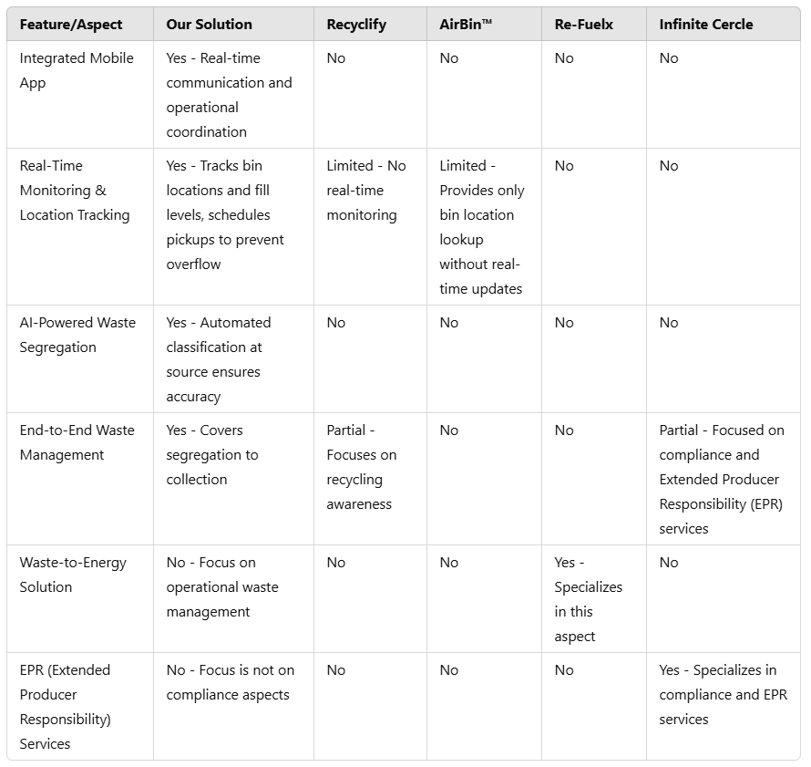
7. Competitive analysis
"Revolutionizing Waste Management through Innovation"
Our solution stands out by offering comprehensive, real-time monitoring, AI-powered waste segregation, and seamless communication channels between residents and waste collectors. With a focus on end-to-end waste management, we address key issues like waste overflow, lack of awareness, and inefficient collection—transforming waste management into an efficient, sustainable process.

Slide 16
8. Market Traction
Development Milestones:
Functional Prototype Completion: Integrated AI/ML for automated waste classification.
Mobile App Launch: Real-time waste monitoring app is fully operational.
Prototype Testing & Presentation: Successfully tested and presented as part of our DP project.
Early Feedback:
User Satisfaction: Positive feedback on ease of use and waste segregation efficiency.
Scalability Potential: Significant scope for scaling to larger campuses and urban areas .

Slide 17
9. Future Plan
Current Status:
Our Intelligent Waste Management System is currently in the prototype phase with key features implemented:
Product Development :- Smart bins use AI for automated waste classification and segregation..
Mobile Application :- Real-time bin tracking is live; GPS integration coming soon.
Team Involvement :-Core team specializes in AI, ML, sensors, and app development..
Testing:- Early results are promising but real-world validation underway.
Growth Strategy:
Product Development (Next 6-12 months):
GPS Integration:- Enable real-time bin location tracking for efficient scheduling.
Automated Waste Disposal System:- Touch-free system with AI-powered waste classification.
App Features:- Adding analytics, mess waste tracking, and a complaint portal

Slide 18
9. Future Plan
2. Market Expansion & Customer Acquisition:
Target Educational Institutions & Campuses: Target campuses and schools to promote sustainable waste management.
Collaboration with Municipalities: Partner with municipalities for citywide waste management integration.
Expanding Residential & Commercial Sectors: Expand to housing societies and businesses needing scalable solutions.
3. Fundraising & Financial Growth:
Seek Funding via Grants & Investors: Pursue grants and eco-focused investors for scaling and development.
Strategic Partnerships for Market Access: Collaborate with tech firms and initiatives for market expansion.

Slide 19
10. Support required from Catalyst
Financial Support: Funding for product development, scaling production, and executing targeted marketing strategies.
Mentorship: Advice on strategy, finding opportunities, and attracting investors.
Technical Expertise: Access to specialized knowledge in AI, machine learning, and sensor technologies.
Networking Opportunities: Connect with industry leaders, investors, and potential partners, facilitating collaboration and expanding market reach for long-term success.

Slide 20
Contact Us
For any questions kindly contact:
Email: b23394@students.iitmandi.ac.in
LinkedIn: Arendra Kumar - SAE@iitmandi | LinkedIn Phone: +91 9999802132, +91 7300516023

